Slide 1
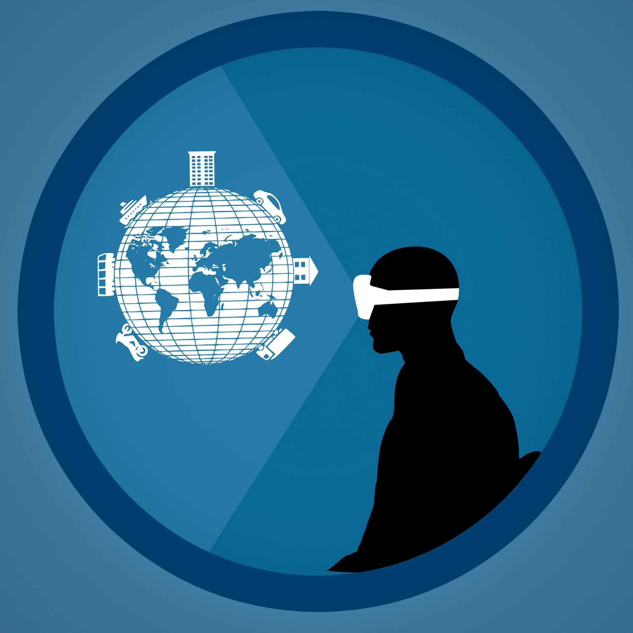
Augmented museum
CS 5330 – Final Project
Kevin Heleodoro
Notes:
NOTE: Want a different image on this slide? Select the picture and delete it. Now click the Pictures icon in the placeholder to insert your own image.

Slide 2
Introduction
Use Augmented Reality (AR) to display paintings and images onto real surfaces
Implement Marker-Based detection using ArUco markers
Allow users to display their favorite images in "life-size" on a live video feed

Slide 3
Related Work
The Use of Marker-Based Augmented Reality in Space Measurement
Used physical ArUco markers arranged in a room to measure the overall size of the space.
Mobile Augmented Reality (AR) Marker-based for Indoor Library Navigation
Used virtual markers recognized by their program to display navigational instructions in real time.
ArUco marker-based displacement measurement technique: uncertainty analysis
Used physical markers to measure the displacement of a vibrating structure.

Slide 4
Process
Load the images and resize them to (560, 720)px.
Set the coordinates system for the ArUco marker based on the predefined length of 200px.
Detect the ArUco marker within a frame.
Find the markers pose from 3D to 2D point correspondence.
Warp the overlay image using the homography matrix.
Compute the homography from the overlay image to the projected points.
Project those 3D points onto a 2D plane using the camera matrix and distortion coefficients.
Calculate the proposed 3D corners for the newly resized overlay image.
Create a mask where the overlay image is positioned.
Create the inverse of that mask for the background.
Prepare background image by masking out overlay area.
Combine the background and warped overlay.

Slide 5
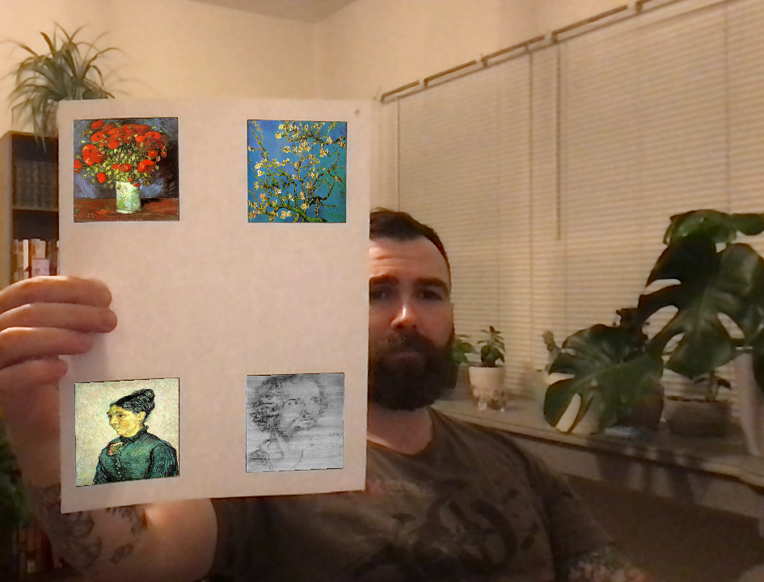
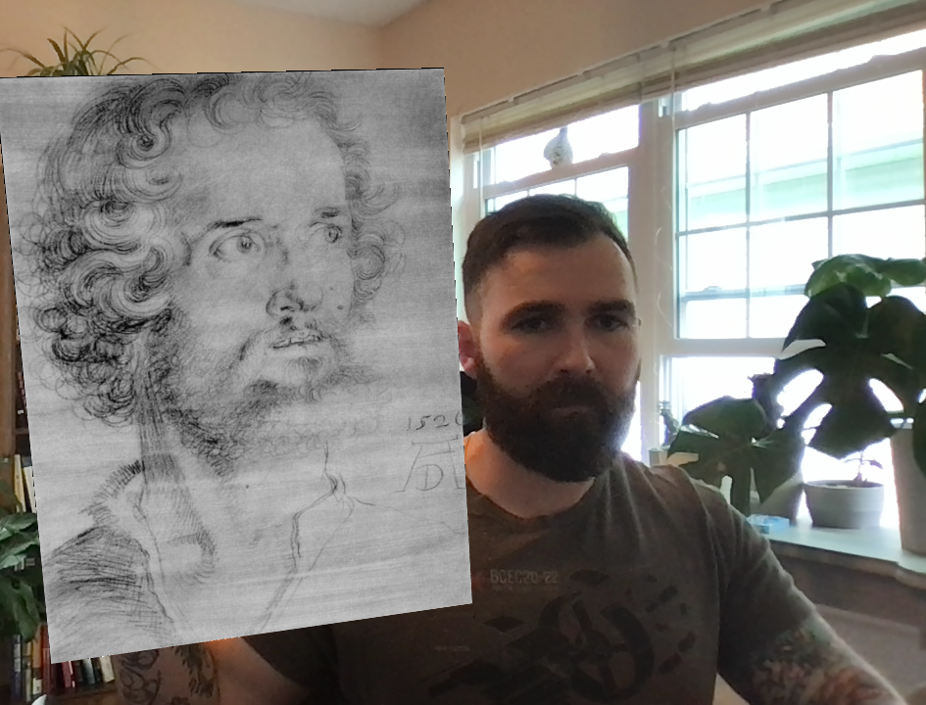
My solution
Overlaying multiple images
Overlaying single full-size image

Slide 6
Thank you!
Augmented Museum – Kevin Heleodoro

